Slide 1
Language of Business Writing & Business Letter Writing (Formatting)

Slide 2
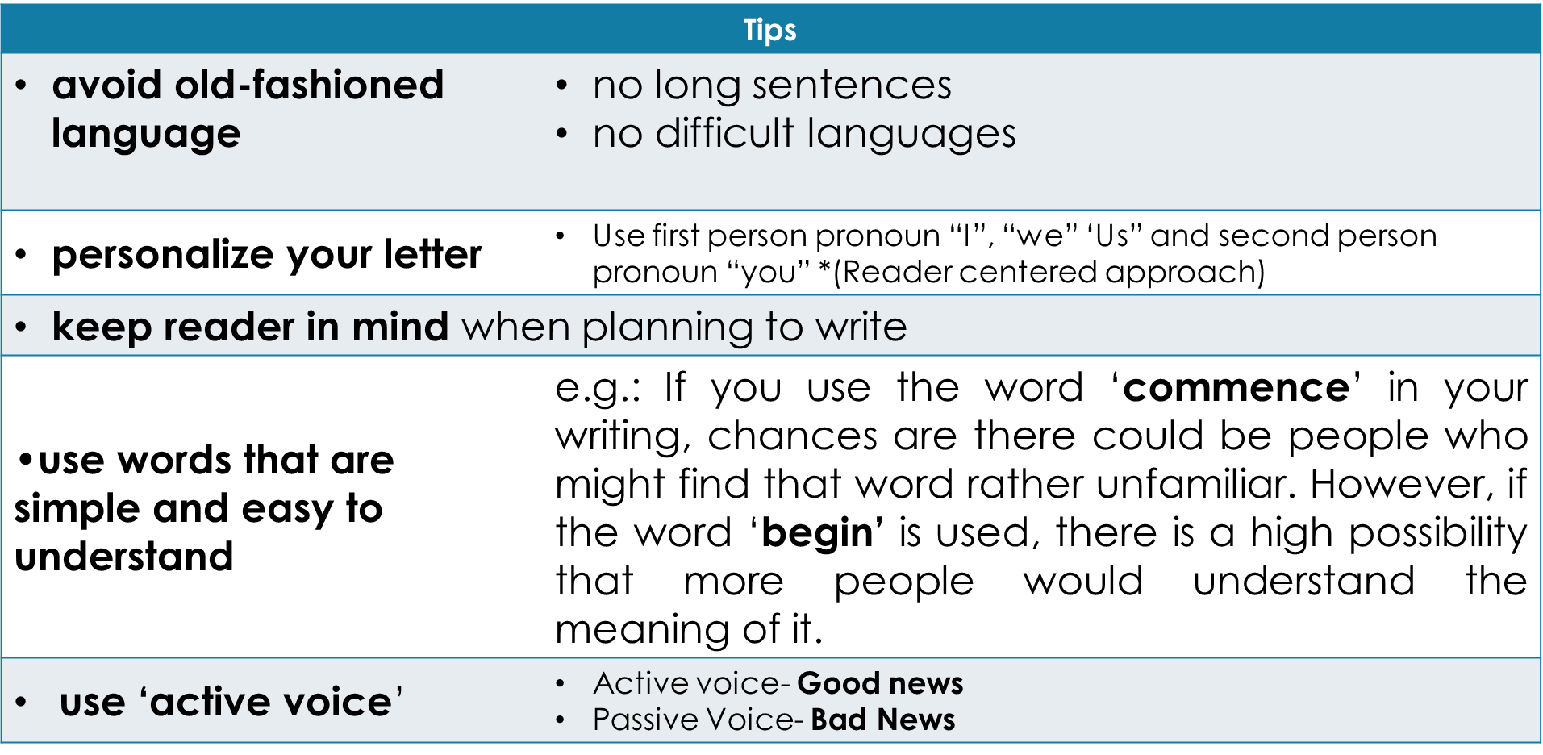
Language of Business Writing

Slide 3
Tone It is important to try to get the right 'tone' in your message. **Aim for a neutral tone

Slide 4
Elements of a business letter
- letterhead (optional)
- return address
- date
- inside address
- salutation
- subject
- body or text
- complimentary close
- signature
- name and title lines
- enclosure (optional)

Slide 5

Letterhead
A business letterhead is a printed header at the top of a company letter.
Normally includes a business's logo and company’s details.
Located on top of the page

Slide 6
Return Address (writer’s information)
2 situations:
From a company: name, position, company’s name and company’s address
From an individual writer: name, home address

Slide 7
Date
The date is written bellow the sender’s address - separated from it by a space.
Three most common forms:
October 27, 2026
27 October 2026
2026 October, 27
The month is never abbreviated, the day is never spelled out.

Slide 8
Inside Address
The information of the recipient:
To a company:
Name
Position
Company’s name
Company’s address

Slide 9
Inside Address
To an individual recipient:
Name
Home address

Slide 10
Salutation
Example:
Dear Sir
Dear Madam
Dear Sir or Madam
Dear Mr. James
- Should be written below the address and with a space of one or three lines before the subject.
- It is followed by a comma (,) or a colon (:).

Slide 11
Subject
Example:
SUBJECT: New Office Policy
The subject title:
- Immediately draws attention to the topic of the document
- Quickly identifies the purpose of the letter
- Should be only ONE line.

Slide 12
Body of the letter
Deals with:
- how much information to give?
- which approach to be used?
The length:
- paragraphs – minimum (3) and maximum (5)
**some letters can be written more than 5 paragraphs (persuasive)

Slide 13
Style
- Avoid jargon and other unnecessary words.
- “We” should be used when writing on behalf of your company or a group of associates.
- “I” should be used when writing as an individual writer.

Slide 14
Sequence/ Arrangement
Based on the approach (direct or indirect)
Direct (3 steps)
Indirect (4 steps)

Slide 15
Complimentary close
Options: Yours sincerely,Yours faithfully,
- If the letter begins with Dear Sir, Dear Madam, or Dear Sir or Madam, it will close with Yours faithfully.
- If the letter begins with personal name (Dear Mr.
James), it will close with Yours sincerely.
Leave one-three line between the last paragraph of the letter and the complimentary close.

Slide 16
Signature Block
- The signature block consists of your signature, name and your position in the firm (if required).

Slide 17
Enclosure line
Enc. 2)Encl. 3)Enc: 4)Encl:
- Enclosure(s) is used when the writer needs to send secondary document (supporting document) with the letter
- They can be mentioned at the bottom of the letter after Enc. /Encl. / Enc: / Encl:
- If there are few documents to be enclosed, then it should be listed and numbered.

